Slide 1
3013 Adv Algorithms
Presentation
By: Tairique Davis

Slide 2
Boruvka's Algorithm for Minimum Spanning Trees
This presentation provides an introduction to Boruvka's algorithm, a graph theory algorithm used to find the minimum spanning tree of a graph. It covers the history of the algorithm, its functionality, and its advantages and limitations compared to other algorithms.

Slide 3
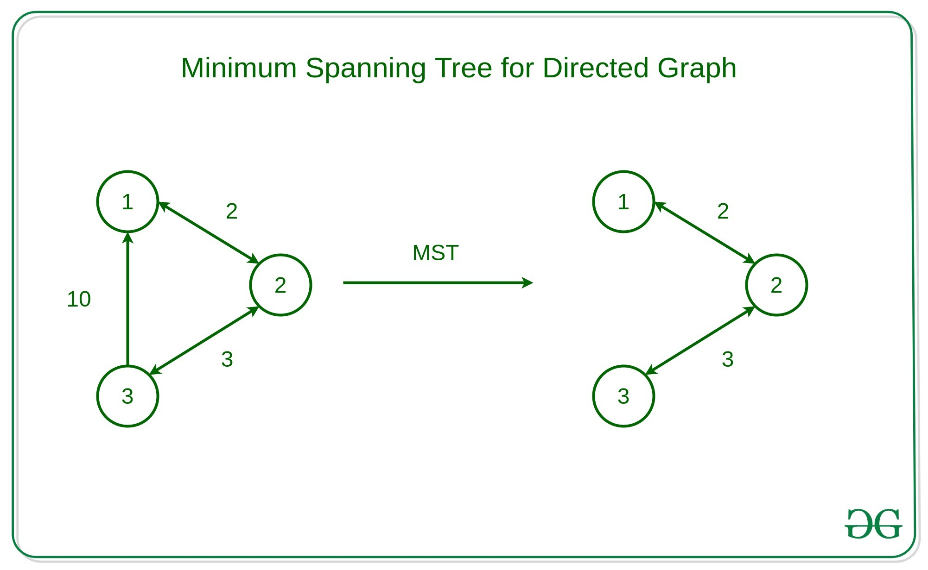
What is a Minimum Spanning Tree?
A minimum spanning tree is a tree that connects all the vertices in a graph with the minimum possible total edge weight.

Slide 4
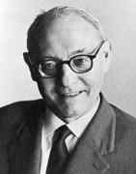
History of Boruvka's Algorithm
Graph theory algorithm used to find the minimum spanning tree of a graph.
Created by Czech mathematician Otakar Boruvka in 1926.
It is a greedy algorithm, meaning it makes locally optimal choices at each step in order to reach a global optimal solution.
Otakar Boruvka

Slide 5
How does it Work?
1) Input is a connected, weighted and un-directed graph.
2) Initialize all vertices as individual components (or sets).
3) Initialize MST as empty.
4) While there are more than one components, do following for each component. a) Find the closest weight edge that connects this component to any other component. b) Add this closest edge to MST if not already added.
5) Return MST.

Slide 6
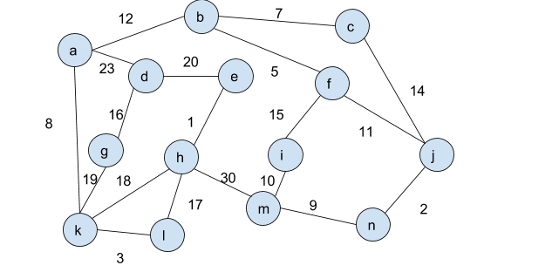
Example

Slide 7
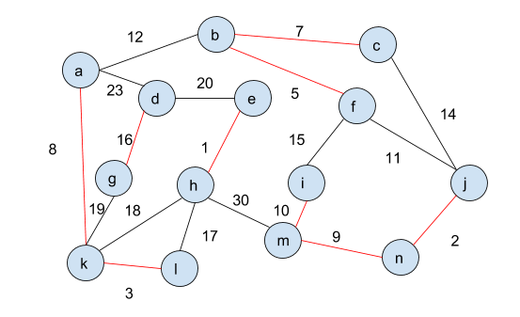
Example(Solved)

Slide 8
Complexity
Time complexity of O(E log V) where E represents the number of edges and V represents the number of vertices
Worst and Best case is O(E log V)
Space complexity is O(V+E) or simply O(N)

Slide 9
Advantages of Boruvka's Algorithm
Simple and efficient
Does not need to presort edges or maintain a priority queue in order to create a minimum spanning tree
Easy parallelized

Slide 10
Limitations of Boruvka's Algorithm
Becomes less efficient in graphs that are more complex with high connectivity compared to Prim’s and Kruskal’s

Slide 11
Thank you for your time 😊

